Slide 1


Python Exercise
Basic data type and flow control

Slide 2
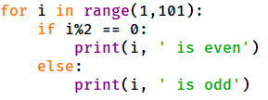
Question 1.1
Fill in the blank place with code. The program makes judgement on number of 1 to 100, print result if is even or odd number.

Slide 3
Question 1.2
Fill in the blank place with code. The program makes judgement on number of 1 to 100, print result if is even or odd number.

Slide 4
Answer
Question 1

Slide 5
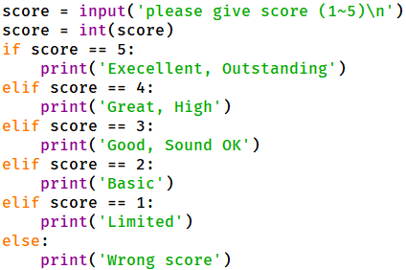
Question 2.1
Fill in the blank place with code. The program checks student score and gives evaluation result.

Slide 6
Question 2.2
Fill in the blank place with code. The program checks student score and gives evaluation result.

Slide 7
Answer
Question 2

Slide 8
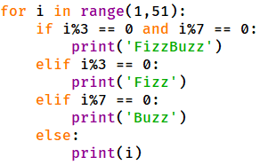
Question 3.1
Fill in the blank place with code. The program print number from 1 to 50. When the number can fully divided by 3, it print ‘Fizz’ instead. When the number can fully divided by 7, it print ‘Buzz’ instead. When the number can be fully divided by 3 and 7, print ‘FizzBuzz’ instead.

Slide 9
Question 3.2
Fill in the blank place with code. The program print number from 1 to 50. When the number can fully divided by 3, it print ‘Fizz’ instead. When the number can fully divided by 7, it print ‘Buzz’ instead. When the number can be fully divided by 3 and 7, print ‘FizzBuzz’ instead.

Slide 10
Question 3
Question 3

